Slide 1
Health Level 7 (HL7) - Foundation
Satish Patel

Slide 2
HL7 – What is it
Health Level 7 - Represents the Application Layer (Level 7) of the OSI model
ANSI accredited Standard Developing Organization
Widely accepted communication standard between healthcare systems
Emphasis on semantic interoperability
Information Source: HL7 2006 Normative Edition

Slide 3
HL7 Versions
Version 2.x – “Vertical Bar” encoding
  Very flexible
  Large scale adoptions
  Most organization has their own implementation
  Very little Interoperability
Version 3 (V3) – XML based structure for messages
  Complex structure
  Early stage of adoption
Information Source: HL7 2006 Normative Edition

Slide 4
HL7 Foundation Components
Information Model
Vocabulary
Implementation Technology Specifications
Data Types
Common Message Element Types
Information Source: HL7 2006 Normative Edition

Slide 5
HL7 Information Model
Structured specification of information
Defined information models
  Reference Information Model (RIM)
  Domain Message Information Model (D-MIM)
  Refined Message Information Model (R-MIM)
Information Source: HL7 2006 Normative Edition

Slide 6
Reference Information Model
Object model developed with HL7 V3
Represents the domain model for clinical data
Base model for all HL7 messages
Incorporates the life cycle of events that HL7 message(s) carries
Information Source: HL7 2006 Normative Edition

Slide 7
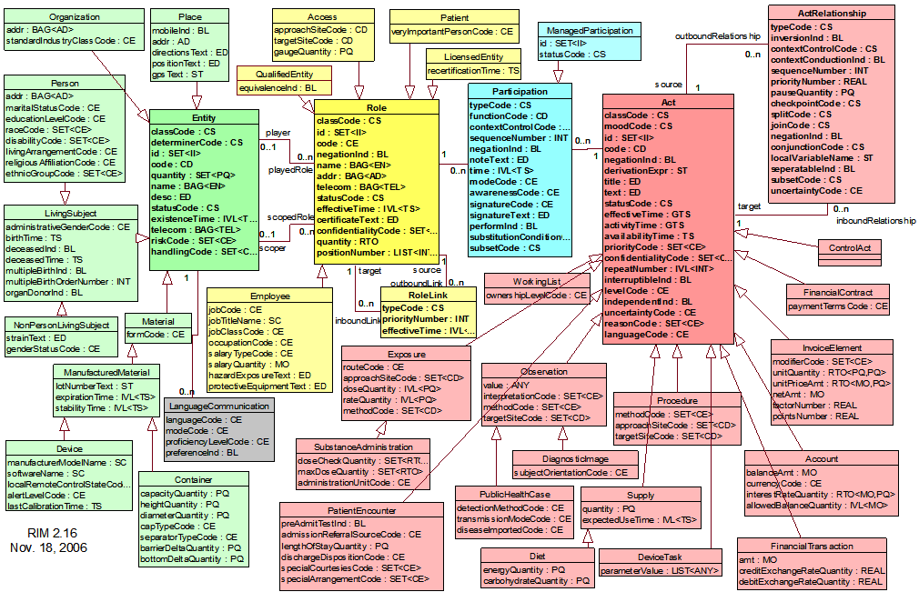
HL7 RIM – 2.16
Diagram Source: HL7 2006 Normative Edition

Slide 8
Domain Message Information Model
Subset of HL7 RIM model
Defines information model specific to a domain of interest
Information Source: HL7 2006 Normative Edition

Slide 9
Refined Message Information Model
Subset of HL7 D-MIM model
Defines information model specific to a message of interest
Information Source: HL7 2006 Normative Edition

Slide 10
HL7 Vocabulary
One of the key drivers for interoperability
Set of valid values for any attributes
  Enumeration in Java
  Permissible Values in caDSR Value Domain
  ValueSet in EVS
Information Source: HL7 2006 Normative Edition

Slide 11
Implementation Technology Specs.
Wire format for the XML messages
Encoding of characters in the messages
Format for extending the XML message schema
Information Source: HL7 2006 Normative Edition

Slide 12
Data Types
Basic building blocks for attributes
  Java e.g.: int, String, float, double
Describes structural format of the data
HL7 data types contains semantic information
  E.g. PNMP – Person Name Part
Information Source: HL7 2006 Normative Edition

Slide 13
Common Message Element Type
It is a message type fragment reusable by other message types
E.g. Principal is composed of
  Person
  Organization
  Device
Information Source: HL7 2006 Normative Edition

Slide 14
HL7 Message Construction
A HL7 message has
  structure similar to HL7 information model (RIM)
  its attributes with types as HL7 data types
  Its attribute’s values restricted by HL7 vocabulary

Slide 15
HL7 Data Types in UML

Slide 16
SDK Requirements
Allow users to specify HL7 data types in the application’s UML domain model
  Generate the O/R mapping layer for the HL7 data type based attribute and classes
  Allow SDK users to use HL7 data type enabled objects across all client tiers i.e. Java API, Web UI, Web Services, and XML Clients

Slide 17
Definitions
A Data Type defines a set of values and the allowable operations on those values
  Java example: Integer, Float, Double
Attribute = Attribute Name + Data type
  Java example: private Float totalValue;
Class = collection of attributes

Slide 18
Java Data Types in UML
Example with Java data types usage in UML class
Class: Address
Attribute
Attribute
Name
:
Data Type
Street1
:
String
Attribute
Street2
:
String
Attribute
Zip
:
Integer

Slide 19
HL7 Data Types in UML
Example with HL7 data types usage in UML class
Class : Person
Attribute
Attribute
Name
:
Data Type
addr
:
AD
Attribute
gender
:
CE
Attribute
ethnicity
:
SET<CE>

Slide 20
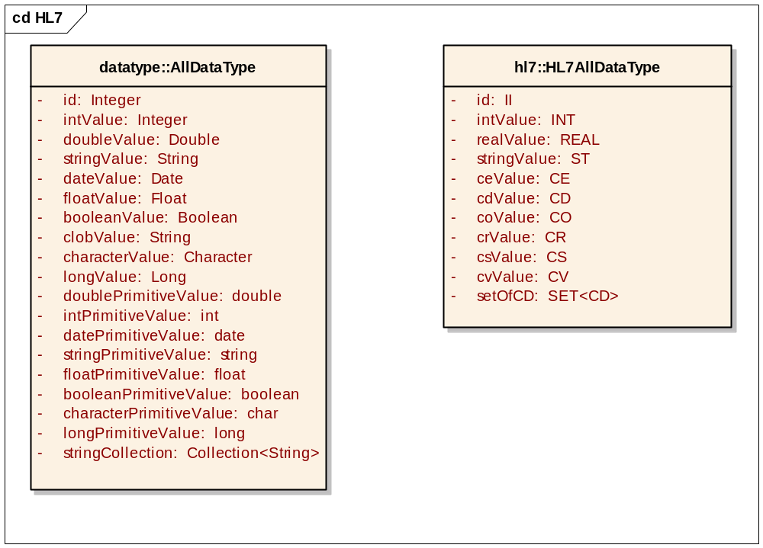
Data Types in UML
Java Types
(Before)
HL7 Types
(After)

Slide 21
Query Example
Example : Find all MALE person.
HQL : from Person where gender.code=‘MALE’
gender attribute has type as ‘CE’ which has hidden identified attribute named ‘code’
Class : Person
Attribute
addr
:
AD
Attribute
gender
:
CE
Attribute
ethnicity
:
SET<CE>

Slide 22
HL7 Data Type Details

Slide 23
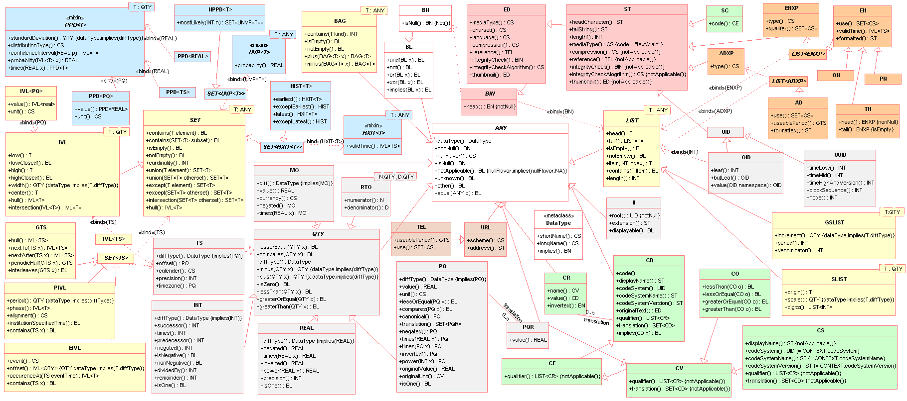
HL7 Data Types – UML View
Diagram Source: HL7 2006 Normative Edition

Slide 24
HL7 Data Types - Classification
Data Type Category | Explanation | Example Data Types
Basic Data Types | These describe 31 of the 42 data types that HL7 defines | Text Codes Identifiers Names Addresses Quantities
Generic Collections | Data Types where a number of values may be included. They are not complete data types as any collection will have an associated Data Type from one of the other Data Type groups listed here | Sequence BAG SET
Generic Type Extensions | Ability to extend existing Data Types through a formal extension language | Not supported in current XML ITS
Timing Specifications | All timing requirements | IVL, Time Interval
Information Source: HL7 2006 Normative Edition

Slide 25
HL7 Data Types
Data Types are defined as interfaces
  Implementation of the data types required
  Understanding of complex validation and parsing algorithm needed
Usage of complex Data Types has two problems
  Storage and Retrieval of attributes using complex types
  Searching the objects based on value of complex data type’s attributes

Slide 26
HL7 Data Type - Persistence

Slide 27
Persisting Data Types as XML
Easy to store
Easy to retrieve
Tricky to search on XML in relational database

Slide 28
Persisting HL7 Data Types as Associations vs. Attributes
Different representation at the UML level
No difference from Java class perspective
Database mapping is different
  Associations are persisted into a separate table
    Most associations are not One-to-One
    Life cycle of associated class is not always controlled by other classes
  Attributes are persisted in the same table as the class
    Class have one to one mapping with attribute
    Life cycle of attribute is controlled by the parent class

Slide 29
Persisting HL7 Data Types –
Hybrid Approach
Can be mapped to the database table as
  Simple value to one column. E.g. String to Varchar
  Complex value to multiple columns
  Collection of simple/complex values to a separate table or as XML blurb

Slide 30
HL7 JavaSIG
Reference Implementation of HL7 V3 Specifications
A complete system for HL7
  Driven by HL7 V3 RIM model
  Persist V3 message in relational database
  Formulates V3 message from message IDs
Information Source: HL7 JavaSIG

Slide 31
JavaSIG – Under the Hood
RIM represents the domain model for the system
RIM classes are generated from HL7 MIF files
  MIF: Model Information File
Pre-constructed hibernate mapping files to map RIM domain model to the relational database
Pre-constructed library of HL7 basic data types
  Currently does not support all the data types
Supports HL7 Vocabulary needed for RIM model
  Can be extended to generate full Vocabulary
Information Source: HL7 JavaSIG

Slide 32
JavaSIG – HL7 Data type
Data Type Category | Database Mapping | Searchable
Simple Data Type | String | Yes
Complex Data Type | XML | No
Complex Data Type with Identified Column | N+1 Column (N identified Strings + XML) | Searching in identified columns
Generics | Separate table with data as defined in first three category | ?
Information Source: HL7 JavaSIG

Slide 33
JavaSIG - Limitations
Supports only basic HL7 data types and generics
Supports vocabulary related to only the RIM model implemented by JavaSIG
Complex HL7 data type is persisted in two parts
  Identified attributes
  XML blurb
Searching is limited to only identified attributes
Information Source: HL7 JavaSIG

Slide 34
Technical Challanges
Modify the code generator to interpret HL7 types
Modify query translators to interpret HL7 types
Generating XML for HL7 type which is compatible with HL7 XSD for data type
XML serialization/de-serialization over grid
CQL query support for the data type
Extending JavaSIG API
caAdapter integration with SDK generated system
Performance

Slide 35
Non-Technical Challenges
Define the use cases for the HL7 data types in caBIG community
Identify the HL7 data types needed in the caBIG community
Pave the path for full HL7 support in SDK

